Slide 1

Programmer Jobs
© 2015 Team Programmer Jobs

Slide 2
Overview
Introduction
Data Model
The Front-end
The Back-end
The Critiques

Slide 3
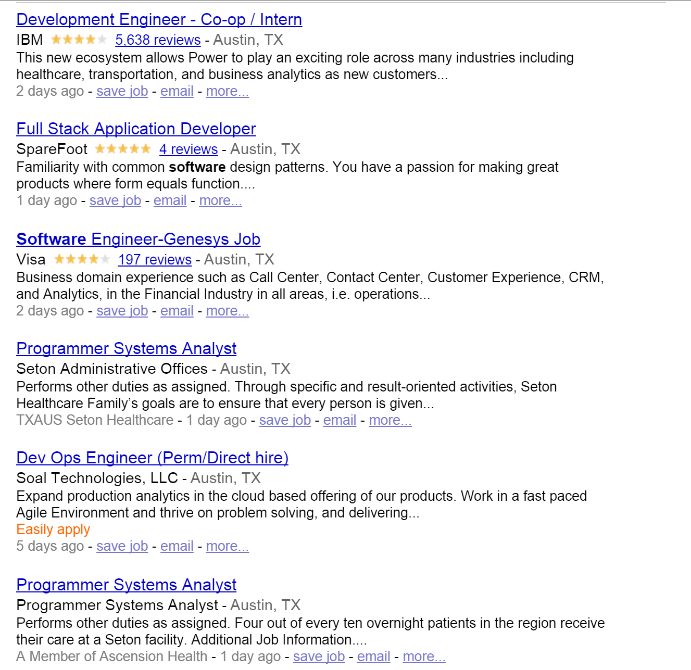
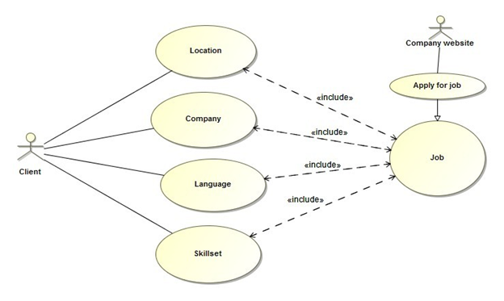
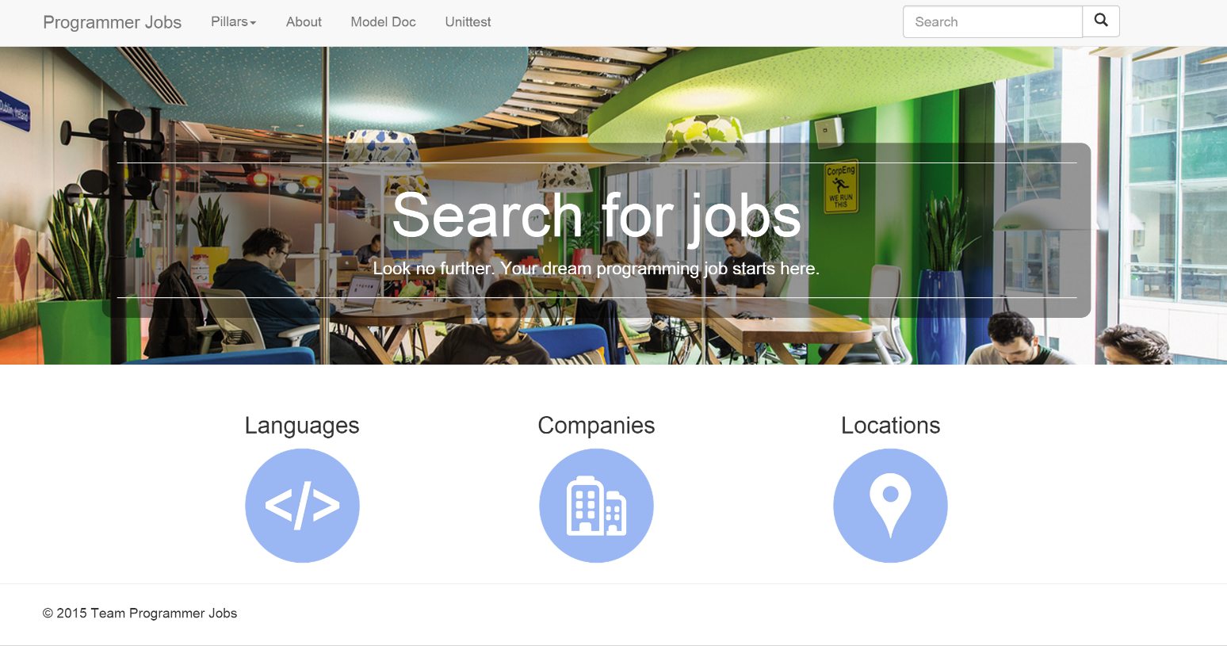
Introduction
What is Programmer Jobs Database ?
What problems do we solve ?
Our use cases.
Phase I Leader
Full Stack
Da Meng
Responsibilities
First team leader, assigning work to each team member, helping communication within the team, data model design, collecting data, designing pages.
Stats
78 commit(s)
9 issue(s)
Notes:
We find that when a person is searching for a job, normally he could only filter the job information with a few criteria, mostly location and company. This will lead to lots of inconvenience. Because there will be a lot garbage information you don’t want to look at. The most annoying part is that the person has to click on the links and look through the description of a job posting to find out if he is qualified or interested in the job.

Slide 4
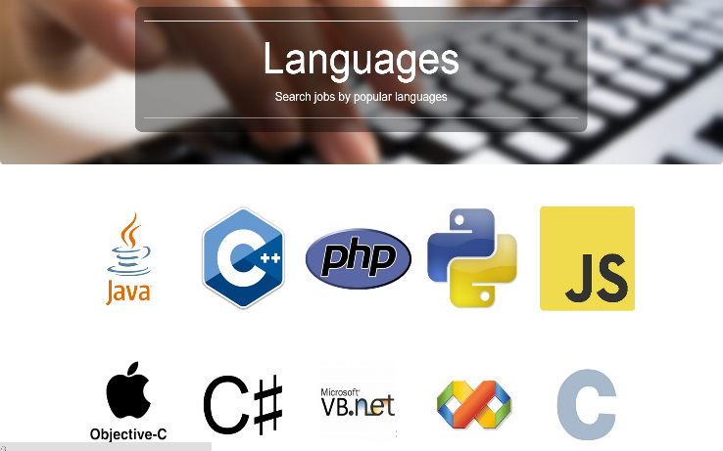

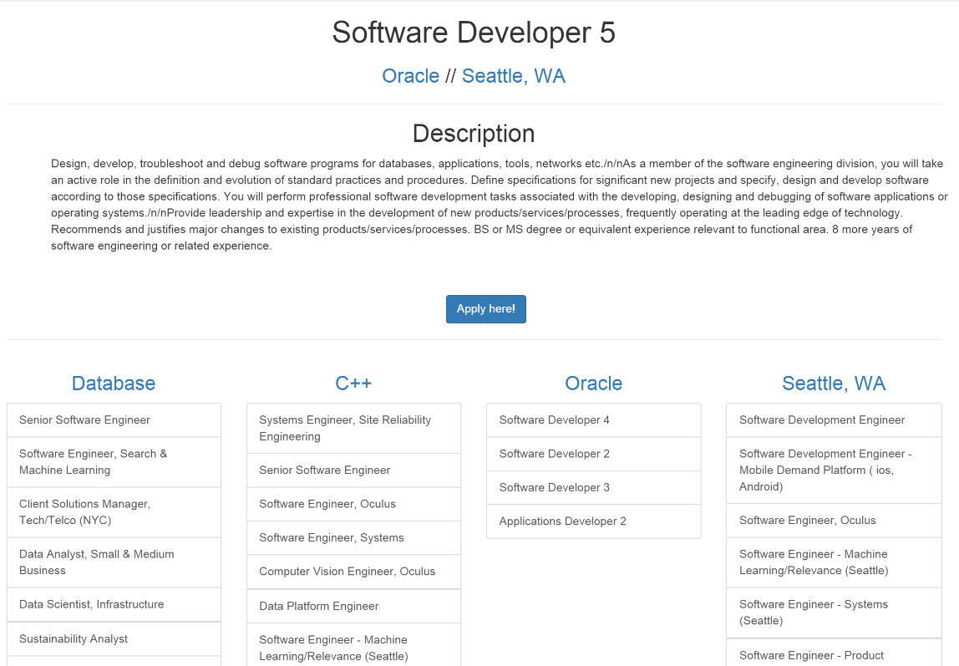

Data Model
Language
language_id
language_name
language_description
language_image
language_wiki_link
Skillset
skillset_id
skillset_name
skillset_description
skillset_image
skillset_wiki_link
Phase I Leader
Full stack
Da Meng
Responsibilities
First team leader, assigning work to each team member, helping communication within the team, data model design, collecting data, designing pages.
Stats
78 commit(s)
9 issue(s)
Company
company_id
company_name
company_description
company_image
company_site
Jobs_Lans
job_id
Language_id
Jobs_Skills
job_id
skillset_id
Job
job_id
job_title
job_description
location_id
company_id
link
Location
location_id
location_name
location_description
location_image

Slide 5
The Front-end
Front-end developer
Chan Hee Park
Responsibilities
Front-end development (HTML, CSS, JavaScript) with usage of Twitter Bootstrap
Stats
77 commit(s)
11 issue(s)

Slide 6
The Front-end(con’t)
Front-end developer
Seung Youp Baek
Responsibilities
Front end development. Static/dynamic page with HTML, CSS, Bootstrap, and JavaScript etc.
Stats
115 commit(s)
19 issue(s)

Slide 7
The Back-end
Back-end developer
Phase II Leader
Kevin Valle
Responsibilities
Back-end development with Flask, SQLAlchemy and linux administration on Rackspace server.
Stats
50 commit(s)
25 issue(s)
15 unittest(s)

Slide 8
Demo time http://104.130.229.90:5000/index

Slide 9
Critiques
Data Scientist
Jin Ho Kim
Responsibilities
Apiary Contribution, data entry, etc.
Stats
15 commit(s)
5 issue(s)
24 unittest(s)

Slide 10
Thank You
© 2015 Team Programmer Jobs

